Slide 1
Security Architecture Diagram (Sample)

Slide 2
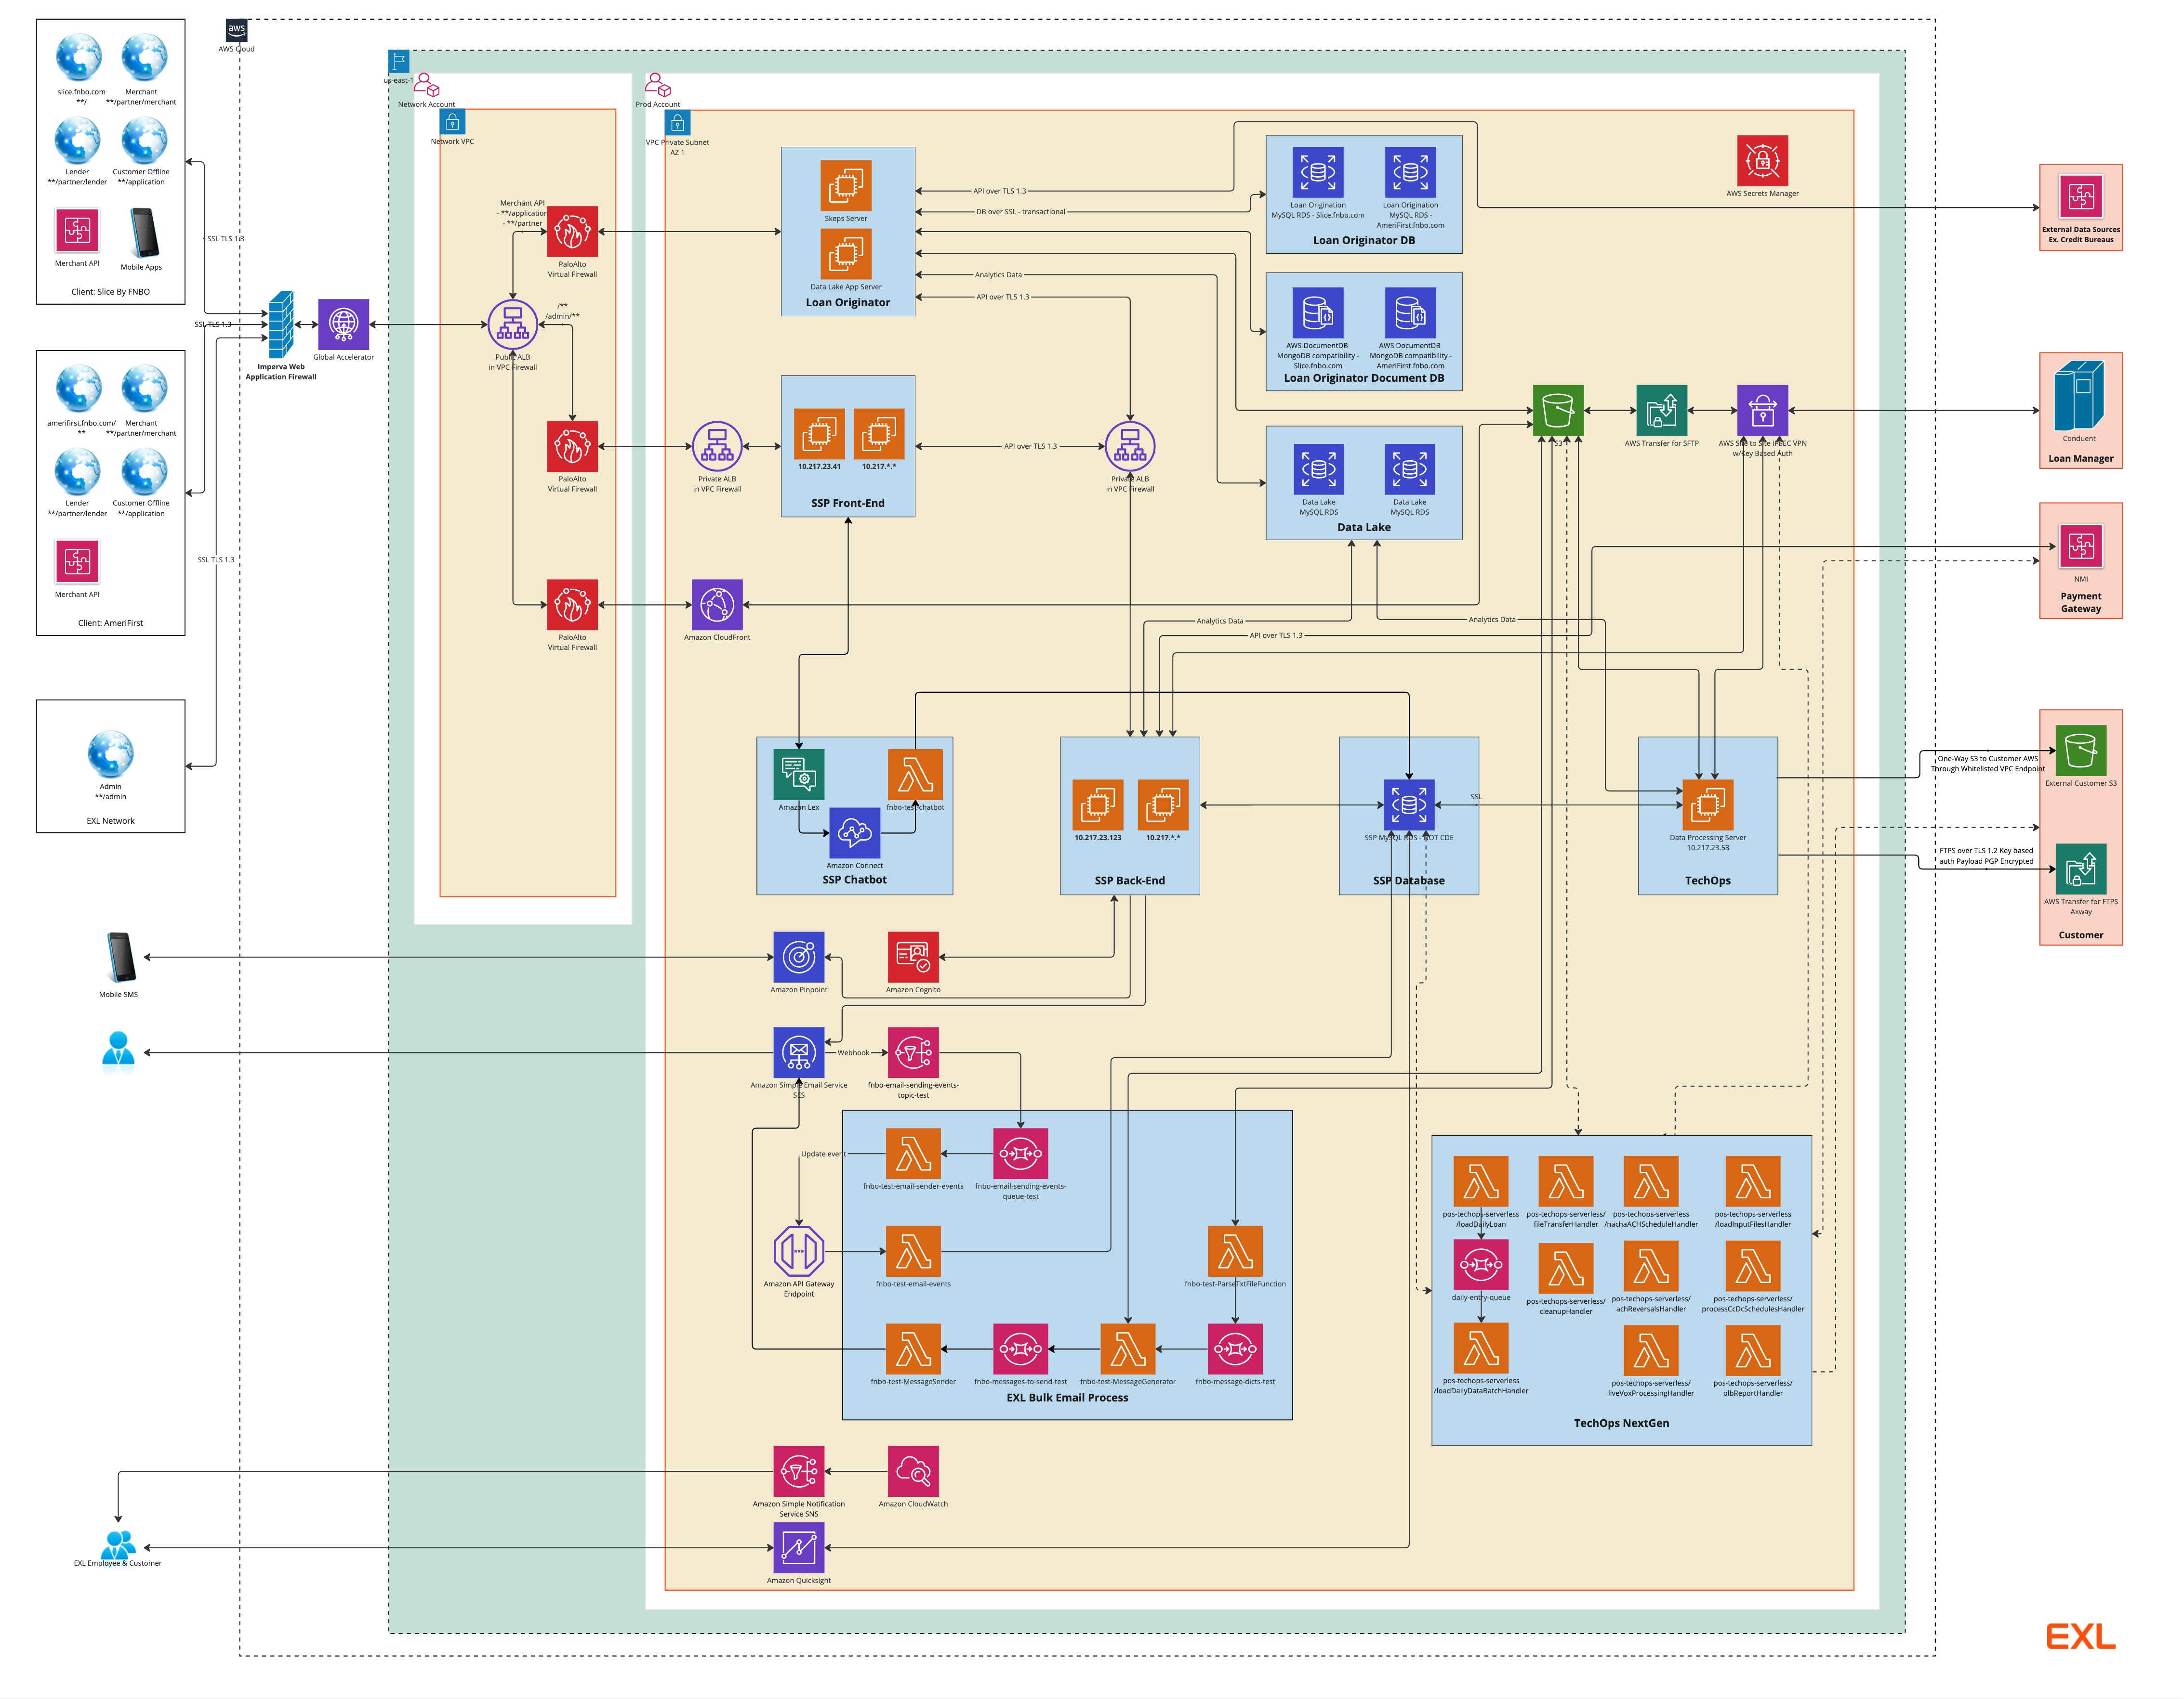
High Level Design Diagram (Including Traffic Flow) – End to End Component Level (this is Sample)

Slide 3
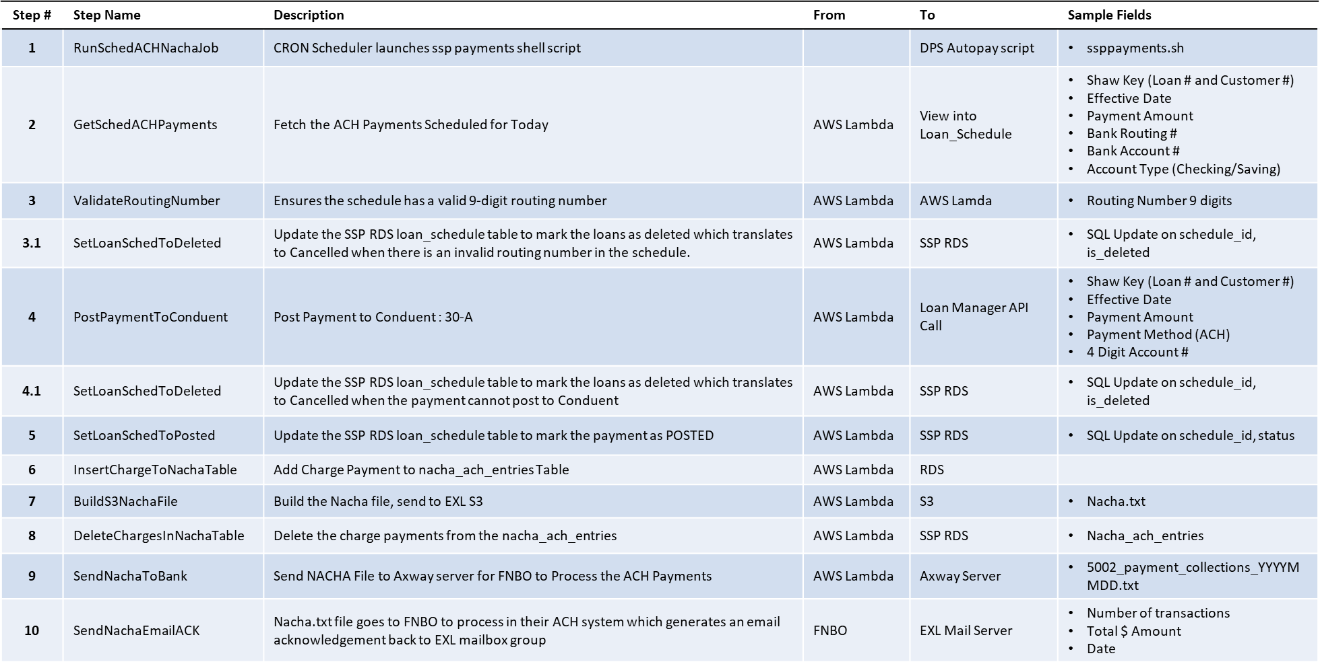
Workflow – Chronological Order(sample)
Internal Document ©2025 Exl Service Holdings, Inc. All rights reserved.

